Slide 1
Project Presentation

Slide 2


Predicting Hotel Rating
Jamila Zaab Al shahrani

Slide 3
Introduction
Hotels play a crucial role in traveling and with the increased access to information new pathways of selecting the best ones emerged.
The dataset contains of 1,000 hotels and their reviews provided by Datafiniti's Business Database. The dataset includes hotel location, name, rating, review data, title, username, and more. It contains about 19 columns.
In this project , I did some exploratory data analysis for the dataset to better understanding the data and what most features are important .
Then , I build many models to predict hotel rating from reviews . Like decision tree , random forest and linear regression.

Slide 4
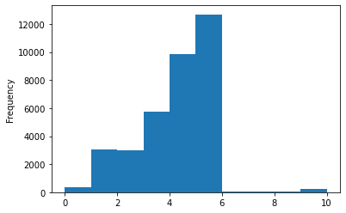
Data Visualization

Slide 5
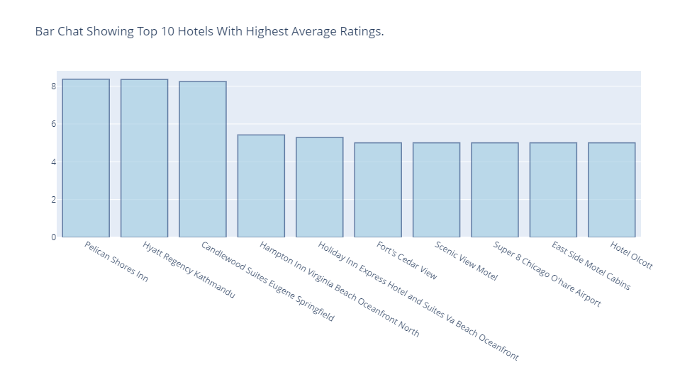
Data Visualization

Slide 6
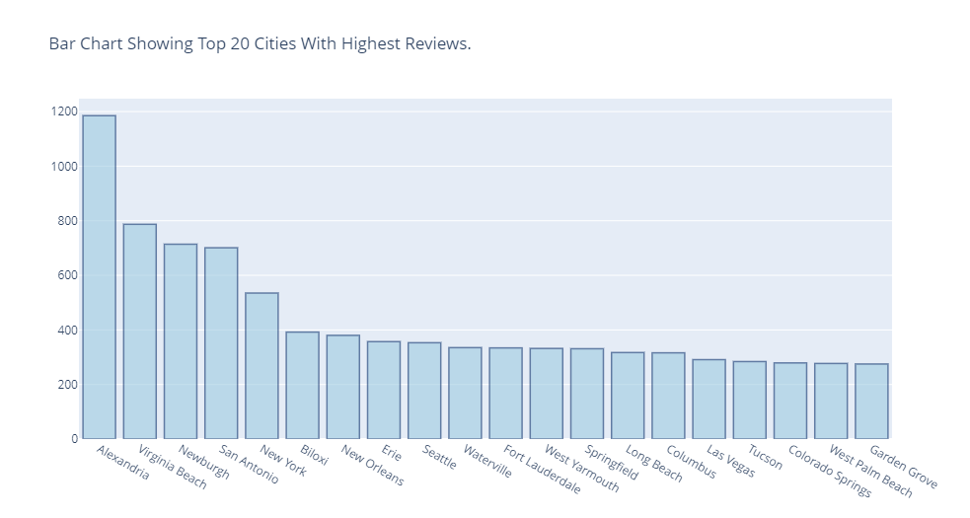
Data Visualization

Slide 7
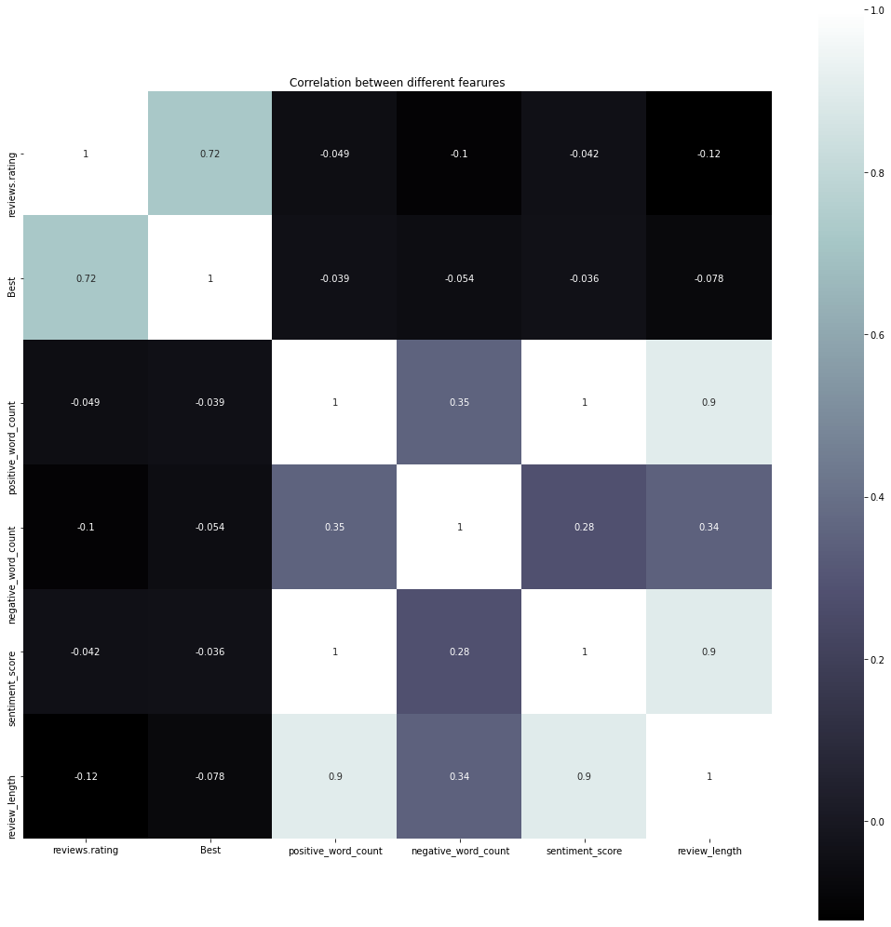
Data Visualization
Correlation matrix between different features.

Slide 8
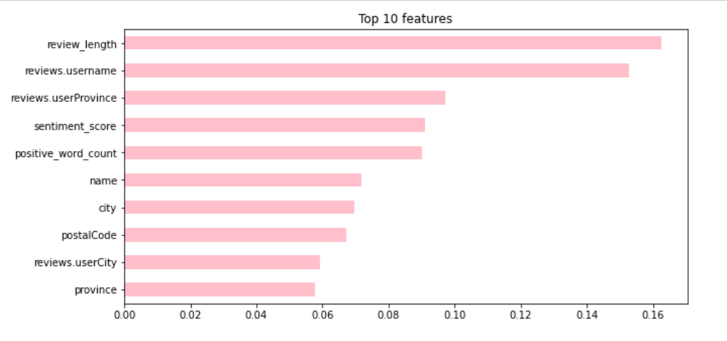


Machine Learning Models and Cross validation
Random Forest model with one Hot encoder.
Random Forest model with one ordinal encoder.

Slide 9


Machine Learning Models and Cross validation
Decision Tree Model.
Linear Regression Model.

Slide 10

Thank you

